Slide 1

Final Project
A Comparative Analysis of five Machine Learning Algorithms for predicting Supply Chain profitability
Antonio Caruso
School of Computing
National College of Ireland
Dublin, Ireland
Email: x19203608@student.ncirl.ie

Slide 2
Agenda
Project Goal and Research Objectives
Problem Definition and Research Question
Research Methodology
Exploratory Analysis
Modelling
Results
Conclusion
Project Management

Slide 3
Project Goal and Research Objectives
The project goal was to perform a data analysis on a supply chain dataset to understand whether future orders would be profitable
The following research objectives were identified at the beginning of the project:
Conduct an exploratory data analysis to identify sales patterns, link or trends related to orders to gain useful insight for the research
Apply the best feature selection method to develop the classification models
Compare the applied machine learning algorithms and identify which model had the highest accuracy in predicting whether orders would be profitable

Slide 4
Problem Definition and Research Question
There is an apparent insufficient academic research on the impact of Machine Learning on the Supply Chain Risk Management
Automated models have not sufficiently influenced decision-making processes in the Supply Chain Risk Management (SCRM) field
Only 4% of studies have been conducted on large datasets (Baryannis et al.,2019)
Given the stated problems, the following research question was formulated
“Is it possible to use machine learning to predict orders profitability?
Notes:
G. Baryannis, S. Validi, S. Dani, and G. Antoniou, “Supply chain risk management and artificial intelligence: state of the art and future research directions,” International Journal of Production Research, 2019. [Online]. Available: http://eds.b.ebscohost.com/eds/detail/detail?vid=14&sid=dccc4edc-9639-4887-aad2-64d6ec13e17e%40pdc-v-sessmgr02&bdata=JkF1dGhUeXBlPWlwLGNvb2tpZSxzaGliJnNpdGU9ZWRzLWxpdmUmc2NvcGU9c2l0ZQ%3d%3d#AN=135800702&db=bsu [Accessed Nov. 06, 2020]

Slide 5
Engineering Approach
The following classification algorithms have been applied to compare their accuracy in predicting orders profitability and answer the research question.
Model | Advantage | Disadvantage
Classification Tree | Classifies data rapidly and works well with both numerical and categorical data | Risk of negative impact on the model from data variation
Random Forest | Suitable for big datasets | No particular disadvantages identified
K-Nearest Neighbour | Functional in non parametric pattern classifications | Potential imprecise testing samples and sensitivity to distance metric
Logistic Regression | Intuiting for understanding the influence of numerous independent variables over a single outcome variable. | Risk of obtaining unfair accuracy results due to discrimination towards certain variables
Naïve Bayes | Well performing with numerical variables when normal distribution is assumed | Works with the unlikely assumption of independent predictors

Slide 6
Research Methodology
Data Understanding | DataExplorer package to visualise the data structure and attributes | 180,240 rows and 53 variables identified, of which 22 were categorical and 33 numerical
Data Pre-processing | Dplyr function applied | Removed duplicate variables, variables with N/A values and irrelevant variables related to customer information. 14 variables were left
Feature Engineering | Principal Component Analysis | Resulted in the 5 best numerical predictor variables used to train the models

Slide 7
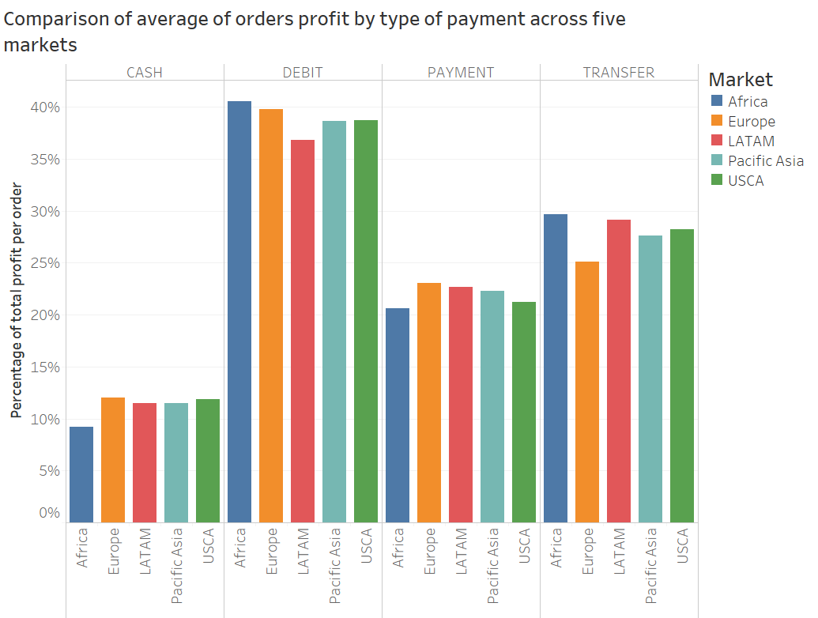
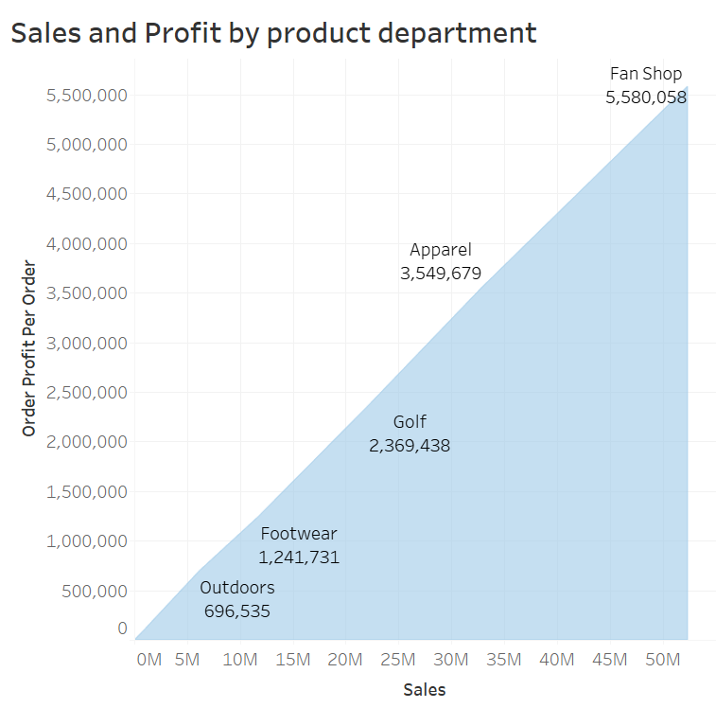
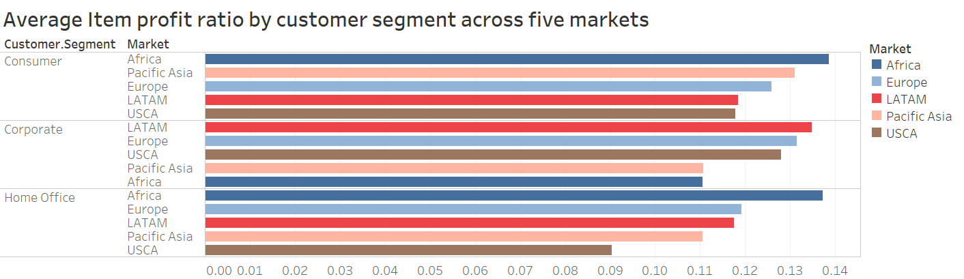
Exploratory Analysis

Slide 8
Modelling
Principal Component Analysis
“order.profit.per.order” | Profit (Target Variable)
“Late_delivery_risk” | LateDelivery (Predictor)
“order.item quantity” | Itemquantity (Predictor)
“Order.Item.Discount.Rate” | Discount(Predictor)
“Days.for.shipment..scheduled.” | Shipment_Scheduled (Predictor)
“Days.for.shipping.real”. | Shipment_Real (Predictor)
CART | Pred: 0 | Pred: 1
Actual: no | TN 1 | FP 9,967
Actual: yes | FN 3 | TP 44,185
RF | Pred: 0 | Pred: 1
Actual: 0 | TN 0 | FP 102,205
Actual: 1 | FN 15 | TP 43,951
Training | Test
70% | 30%
K-NN | Pred: 0 | Pred: 1
Actual: 0 | TN 10,126 | FP 0
Actual: 1 | FN 15 | TP 44,015
Model | Algorithm
Classification Tree | Rpart
Random Forest | randomforest
K-nearest neighbour | knn
Logistic Regression | glm
Naïve Bayes | nb
Confusion matrix of models trained on 70% of data sets compared to test sets
Logistic Regression | Pred: 1 | Pred: 0
Actual: 1 | TP 44,086 | FN 10,070
Actual: 0 | FP 0 | TN 0
NB | Pred: 0 | Pred: 1
Actual: 0 | TN 0 | FP 0
Actual: 1 | FN 9,968 | TP 44,188

Slide 9
Results
 | CART | RF | K-NN | Logistic Regression | NB
Accuracy | 81.59% | 81.12% | 99.97% | 81.41% | 81.29%
Kappa | 0.00001 | 0 | 0.9991 | 0 | 0
The comparison table showed that the best model for orders profitability prediction is K-nearest neighbour with an accuracy of 99.97% and Kappa value as index of reliability of 0.9991
All the other models resulted in the 81% range accuracy, therefore no model except for K-nearest neighbour outperformed each other
An initial attempt which included the ‘Profit Ratio’ predictor had produced improbable perfect results of 100% for Classification Tree and Random Forest and above 98% and 99% for the remaining models.

Slide 10
Conclusion
The research question was positively answered as all the models produced optimal accuracy results above the standard 80% in Machine Learning
The objectives were achieved with successful Exploratory Analysis and PCA providing the best methodology for satisfactory modelling results
Testing and re-evaluating the models has been key to obtaining satisfactory results
The supervised learning approach taken provided additional values from previous work that inspired this project
Application of unsupervised models like clustering is recommended for future work

Slide 11
Project Management

Slide 12
Thank you!

